Slide 2
FINAL / PROJECT / REVIEW
100 %
RITHVIK SINGH
(G4 Lead)
25/09/21
FINAL PROJECT REVIEW

Slide 3
VOTE / OF / THANKS
I’d like to take this chance to thank my parents, teammates, Clevered instructors who have motivated me throughout the course of this internship to strive for the best

Slide 4

A G E N D A
Introduction
Internship journey + Badges earned
App introduction + Demo +Toolkit
Manual + Linkedin&Github launch

Slide 5
M E E T T H E T E A M
R I T H V I K
/ Leader
J A D
/ Member
S A K S H A M
/ Member

Slide 6
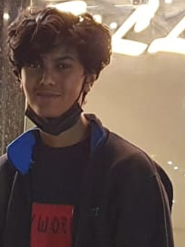
ROCKSTAR BADGE EARNED
R I T H V I K
16, Grade 12
“ The role of AI in our unforeseeable future seems to be exponentially burgeoning, as we transition to a more automated way of life.”
INTERNSHIP SO FAR
FINAL PROJECT REVIEW

Slide 7


PROJECT /
VOICE DRIVEN DESKTOP AI ASSISTANT
FINAL PROJECT REVIEW

Slide 8
W H Y T H I S P R O J E C T ?
CONVENIENCE
Directly assists the user in executing habitual activities seamlessly. A hands-free application is the epitome of convenience, and efficiently taps python capabilities
BROADEN
Plays a role in bridging the gap in user-experience between abled and disabled people, subsequently broadening the demographic of computer-users.
PROSPECT
Additional functionalities can be effortlessly added without tinkering with the core code and adding only more words to listen for in the if..elif statement.

Slide 9



C O N C E P T
Tell time, date, jokes (General)
LISTEN
Perform Google + Wikipedia + YouTube searches
Open any webpage, and play music
SPEAK
Send WhatsApp messages + Emails
Read a pdf
EXECUTE
Surplus functionalities

Slide 10
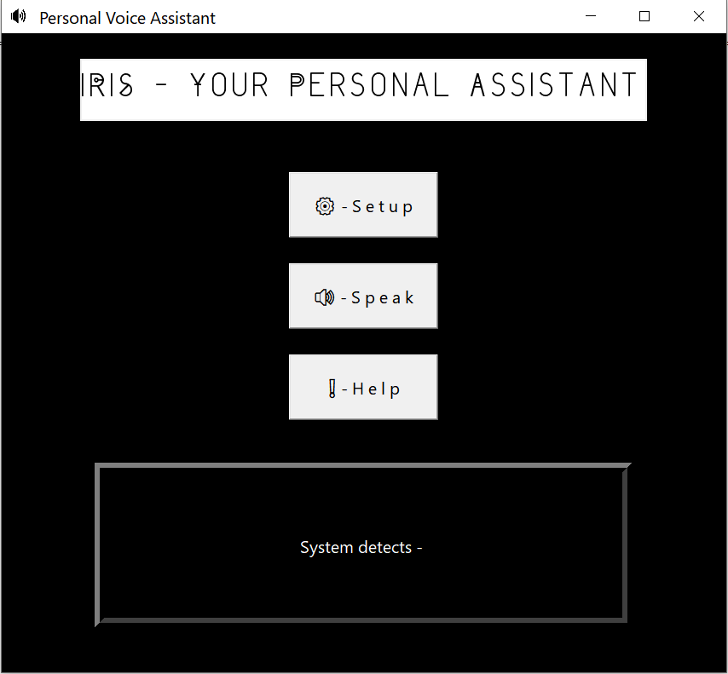
H O W
Iris introduction through title & catchy caption
Setup – Registers user’s name with assistant to personalize commands, and directly address the user
Speak – Needs to be clicked before the user narrates a task, system stops listening after a break of greater than 1 second
Help – Narrates general instructions to enhance application’s utility
Displays what ever the system detects from the user
Tkinter Interface

Slide 11
DEMO
CL I CK
/ ME
“A walkthrough of 2 functionalities of the project”

Slide 12
TOOLKIT
CL I CK
/ ME
“A walkthrough of the toolkit workbook”

Slide 13
GITHUB + LINKEDIN
CL I CK
/ ME
CL I CK
/ ME
“A walkthrough of the social media launch, and GitHub”

Slide 14
B U G S E N C O U N T E R E D
Largely inaccurate speech recognition
PyJokes error – failed to import
PyAudio error – failed to pip install
TTS nonfunctional before root.mainloop()
Failed to send Emails

Slide 15
FUTURE
Incorporate a feature to access and modify directory of contacts vocally
/
Diminish ambiguity or chances of error
/
Tap geolocation
Planned modifications

Slide 16
THANK YOU
END
Questions + Feedback from Mr. Ken

